Slide 1
PROFESSIONAL ETHICS - CE 3142
ETHICAL WORKPLACE RESPONSIBILITIES
THE FACULTY OF ENGINEERING
THE KOTHELAWELA DEFENCE UNIVERSITY
15th March 2024

Slide 2
TOPICS
Loyalty
  Agency loyalty
  Attitude loyalty
Confidentiality
  Definition
  Confidentiality and changing jobs
Conflict of Interest
  Definition
  Gifts, bribes, and kickbacks,
  Interests in other companies, and
  Insider information.
Teamwork

Slide 3
LOYALTY
Loyalty to an employer can mean two things.
Agency-loyalty is acting to fulfill one’s contractual duties to an employer
  These duties are specified in terms of the particular tasks for which one is paid, as well as the more general activities of cooperating with colleagues and following legitimate authority within the corporation
Attitude-loyalty, by contrast, has as much to do with attitudes, emotions, and a sense of personal identity as it does with actions
  It implies seeking to meet one’s moral duties to a group or organization willingly, with personal attachment and affirmation, and with a reasonable degree of trust.

Slide 4
LOYALTY
IESL Clause 6
Agency Loyalty – relevant sub-clauses
  shall at all times avoid all known or potential conflicts of interest. They should keep their employers fully informed on all matters which could lead to such a conflict, and should not participate in any decision which could involve them in conflict of interest.
  shall when acting as administrators of a contract be impartial as between the parties in the interpretation of the contract.
  shall neither solicit nor accept …… free engineering designs, from material or equipment suppliers for specifying their products
  shall neither solicit nor accept gratuities, directly or indirectly from contractors or their agents ……….in connection with work for which they are responsible.
  shall neither disclose nor use confidential information gained in the course of their employment without express permission
  shall not complete, sign, or seal plans an/or specifications that are not of a design safe to the public health and welfare and in conformity with accepted engineering standards.

Slide 5

LOYALTY
Attitude Loyalty – relevant sub-clauses
  shall not accept compensation, financial or otherwise from more than one party for project
  Shall not accept a commission, fee, reward or other benefit from a third party, while advising a client
  shall advise their clients or employers when as a result of their studies they believe that a project will not be viable.

Slide 6
CONFIDENTIALITY
Definition :
The duty of confidentiality is the duty to keep secret all information, deemed by the employer or client, desirable to keep secret
  IESL Code of Ethics Clause 6.8
  Shall neither disclose nor use confidential information gained in the course of their employment without express permission, except where public interest and safety are involved.
Basically, it is any information that the employer or client would like to have kept secret to compete effectively against business rivals. Often this is understood to be any data concerning the company’s business or technical processes that are not already public knowledge.
Within governmental agencies and private companies, engineers and other employees are usually expected to withhold information labeled “confidential” from unauthorized people both inside and outside the organization.

Slide 7
CONFIDENTIALITY
Several related terms should be identified and defined.
Proprietary information is information that a company owns or is the proprietor of, and hence is a term carefully defined by property law. A rough synonym for “proprietary information” is trade secret, which can be virtually any type of information that has not become public, which an employer has taken steps to keep secret, and which is thereby given limited legal protection in common law (law generated by previous court rulings) that forbids employees from divulging it.
Patents legally protect specific products from being manufactured and sold by competitors without the express permission of the patent holder. Trade secrets have no such protection, and a corporation can learn about a competitor’s trade secrets through legal means— for instance, “reverse engineering,” in which an unknown design or process can be traced out by analyzing the final product. But patents do have the drawback of being public and thus allowing competitors an easy means of working around them by finding alternative designs.

Slide 8
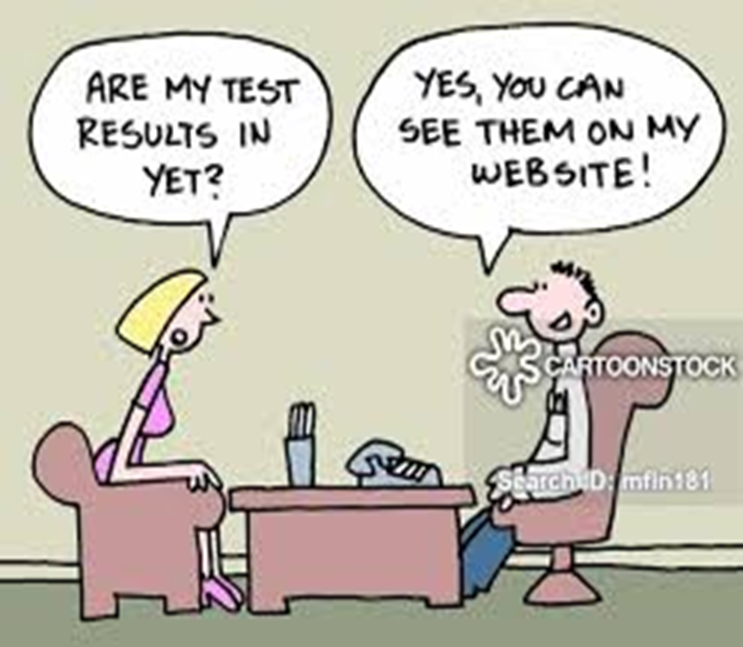
CONFIDENTIALITY
Privileged information literally means “available only on the basis of special privilege,” such as the privilege accorded an employee working on a special assignment.
Confidentiality in health and social care? Those working in the health and social care sector have legal and professional responsibilities to uphold confidentiality. Day to day maintaining of confidentiality means: Ensuring that sensitive conversations are only held in private spaces

Slide 9
Confidentiality and changing jobs
The obligation to protect confidential information does not cease when employees change jobs. If it did, it would be impossible to protect such information.
Thus, the relationship of trust between employer and employee in regard to confidentiality continues beyond the formal employment
Unless the employer gives consent, former employees are barred indefinitely from revealing trade secrets.
This provides a clear illustration of the way in which the professional integrity of engineers is shown, much more than mere loyalty to one’s present employer

Slide 10
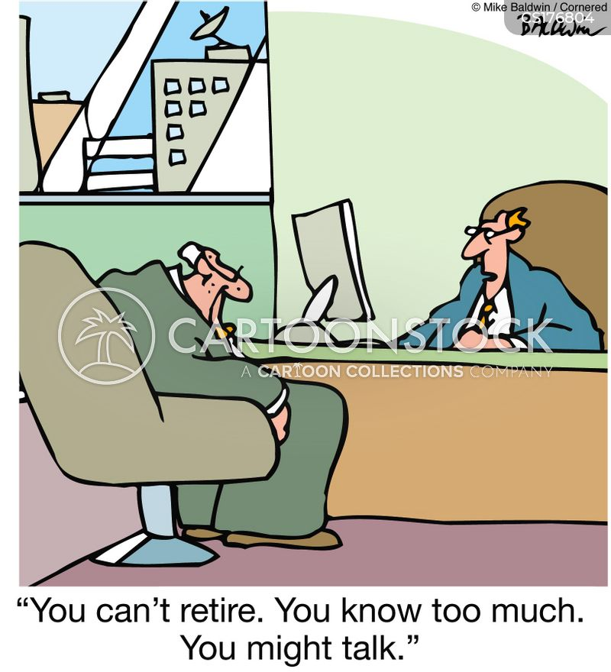
Confidentiality and changing jobs
Many engineers value professional advancement more than long-term ties with any one company, and so they change jobs frequently.
Engineers in R&D are especially likely to have high rates of turnover. They are also the people most likely to be exposed to important new trade secrets. Moreover, when they transfer into new companies they often do the same kind of work as earlier

Slide 11
Confidentiality and changing jobs
Case 1 :
A high-profile case of trade secret violations was settled in January 1997 (without coming to trial) when Volkswagen AG (VW) agreed to pay General Motors Corporation (GM) and its German subsidiary Adam Opel $100 million in cash and to buy $1 billion in parts from GM over the next seven years.
WHY ???
Because in March 1993, Jose Ignacio Lopez, GM’s highly effective manufacturing expert, left GM to join VW, a fierce competitor in Europe, and took with him not only three colleagues and knowhow, but also copies of confidential GM documents.

Slide 12
Confidentiality and changing jobs
Case 2 :
A more legally important case concerned Donald Wohlgemuth, a chemical engineer who at one time was manager of B.F. Goodrich’s space suit division.
Technology for space suits was undergoing rapid development, with several companies competing for government contracts.
Dissatisfied with his salary and the research facilities at B.F. Goodrich, Wohlgemuth negotiated a new job with International Latex Corporation as manager of engineering for industrial products.
International Latex had just received a large government subcontract for developing the Apollo astronauts’ space suits, and that was one of the programs Wohlgemuth would manage. The confidentiality obligation forbid Wohlgemuth from revealing any trade secrets of Goodrich to his new employer.
.

Slide 13
Confidentiality and changing jobs
Case 2 (contd) :
Goodrich charged Wohlgemuth with being unethical in taking the job with International Latex. Goodrich also went to court seeking a restraining order to prevent him from working for International Latex or any other company that developed space suits.
The Ohio Court of Appeals refused to issue such an order, although it did issue an injunction prohibiting Wohlgemuth from revealing any Goodrich trade secrets.
Their reasoning was that although Goodrich had a right to have trade secrets kept confidential, it had to be balanced against Wohlgemuth’s personal right to seek career advancement.
This would seem to be the correct moral verdict as well

Slide 14
Conflict of Interest
DEFINITION :
Professional conflicts of interest are situations where professionals have an interest that, if pursued, might keep them from meeting their obligations to their employers or clients.
  IESL Code of Ethics Clause 1.4
  Shall not participate in assignments that would create conflict of interest between their clients / employers and the public and shall advise the client of their concerns.
  IESL Code of Ethics Clause 6.1
  Shall at all times avoid all known or potential conflicts of interest that involve the engineer himself. They should keep their employers or clients fully informed on all matters, including financial interests, which could lead to such a conflict, and under no circumstances should they participate in any decision which could involve them in conflict of interest.

Slide 15
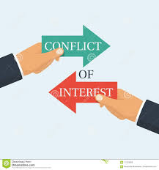
Conflict of Interest
DEFINITION :
Sometimes such an interest involves serving in some other professional role, say, as a consultant for a competitor’s company.
Other times it is a more personal interest, such as making substantial private investments in a competitor’s company

Slide 16
Conflict of Interest
DEFINITION :
Concern about conflicts of interest largely centers on their potential to distort good judgment in faithfully serving an employer or client.
Exercising good judgment means arriving at beliefs on the basis of expertise and experience, as opposed to merely following simple rules. Thus, we can refine our definition of conflicts of interest by saying that they typically arise when two conditions are met:
(1) The professional is in a relationship or role that requires exercising good judgment on behalf of the interests of an employer or client, and
(2) the professional has some additional or side interest that could threaten good judgment in serving the interests of the employer or client—either the good judgment of that professional or the judgment of a typical professional in that situation.

Slide 17
Conflict of Interest
Because of the great variety of possible outside interests, conflicts of interest can arise in innumerable ways, and with many degrees of subtlety.
Let us look at a few of the more common situations involving
  gifts, bribes, and kickbacks,
  interests in other companies, and
  insider information.

Slide 18
Conflict of Interest
Gifts, Bribes, and Kickbacks.
A bribe is a substantial amount of money or goods offered beyond a stated business contract with the aim of winning an advantage in gaining or keeping the contract, and where the advantage is illegal or otherwise unethical.
It involves amounts, beyond acceptable gratuities, that are sufficient to distort the judgment of a person. Typically, although not always, bribes are made in secret.
Gifts are not bribes as long as they are small gratuities offered in the normal conduct of business.
Prearranged payments made by contractors to companies or their representatives in exchange for contracts actually granted are called “kickbacks”.

Slide 19
Conflict of Interest
BRIBE:
If an engineer takes a bribe, he/she is creating a situation that will most likely corrupt his/her professional judgment and tarnish the reputation of the engineering profession.
If he/she offers a bribe, then he/she engages in activity that will also tarnish the reputation of his/her profession if discovered and probably violate his/her obligation to promote the well-being of the public.
Bribery induces the person who takes the bribe to act immorally by violating the obligation to act on behalf of the interests of his client or employer. For example, it can induce a government official to break the obligation to act on behalf of the best interests of the citizenry.
Bribery can undermine the efficiency of the market by inducing someone to buy products that are not the best for the price.
Bribery can give someone an unfair advantage over his competitors, thus violating the standards of justice and fair play.

Slide 20
Conflict of Interest
Gifts, Bribes, and Kickbacks
IESL Code of Ethics Clause 4.1
Shall neither pay nor offer, directly or indirectly, inducements to others.
IESL Code of Ethics Clause 6.3
Shall not accept compensation, financial or otherwise from more than one party for services on the same project, unless the circumstances are fully disclosed and agreed to, by all interested parties.
ESL Code of Ethics Clause 6.4
Shall neither solicit nor accept financial or other valuable consideration, including free engineering designs, from material or equipment suppliers for specifying their products (except such designs obtained with the knowledge and consent of the employer or client).

Slide 21

Conflict of Interest
Gifts, Bribes, and Kickbacks
IESL Code of Ethics Clause 6.5
Shall neither solicit nor accept gratuities, directly or indirectly from contractors or their agents, or other parties dealing with their clients or employers in connection with work for which they are responsible.
IESL Code of Ethics Clause 6.6
Shall not accept a commission, fee, reward or other benefit from a Third Party, while advising a client. Shall not accept a commission, fee, reward or other benefit from a Third Party, while advising a client.

Slide 22
Conflict of Interest
Interests in Other Companies.
Some conflicts of interest consist in having an interest in a competitor’s or a subcontractor’s business.
One blatant example is actually working for the competitor or subcontractor as an employee or consultant.
Another example is partial ownership or substantial stockholdings in the competitor’s business.
Should there be a general prohibition on moonlighting, that is, working in one’s spare time for another company? That would violate the rights to pursue one’s legitimate self-interest..
A special kind of conflict of interest arises, however, when moonlighting leaves one exhausted and thereby harms job performance.
Notes:
Is there a conflict of interest if one’s spouse works for a subcontractor to one’s company? Usually not, but a conflict of interest arises if one’s job involves granting contracts to that subcontractor
Moonlighting usually creates conflicts of interest only in special circumstances, such as working for competitors, suppliers, or customers. Even then, in rare situations, an employer sometimes gives permission for exceptions, as for example when the experience gained would greatly promote business interests

Slide 23
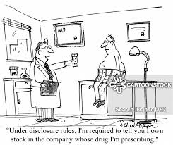
Conflict of Interest
Interests in Other Companies.
  IESL Code of Ethics Clause 6.1
  Shall at all times avoid all known or potential conflicts of interest that involve the engineer himself. They should keep their employers or clients fully informed on all matters, including financial interests, which could lead to such a conflict, and under no circumstances should they participate in any decision which could involve them in conflict of interest.

Slide 24
Conflict of Interest - Example
A professor of electrical engineering at a West Coast university was found to have used $144,000 in grant funds to purchase electronic equipment from a company he owned in part. He had not revealed his ownership to the university.
He had priced the equipment much higher than market value, and some of the purchased items were never received. The required documentation had been submitted as required but with falsified content.
In addition, the professor had hired a brother and two sisters for several years, concealing their relationship to him in violation of antinepotism rules and paying them for research work they did not perform.
All told, he had defrauded the university of at least $500,000 in research funds. Needless to say, the professor lost his university position and had to stand trial in civil court when an internal audit and subsequent hearings revealed these irregularities.

Slide 25
Conflict of Interest
Insider Information.
An especially sensitive conflict of interest consists in using “inside” information to gain an advantage or set up a business opportunity for oneself, one’s family, or one’s friends. The information might concern one’s own company or another company with which one does business.
For example, engineers might tell their friends about the impending announcement of a revolutionary invention, which they have been perfecting, or of their corporation’s plans for a merger that will greatly improve the worth of another company’s stock. In doing so, they give those friends an edge on an investment promising high returns.
Owning stock in the company for which one works is of course not objectionable, and this is often encouraged by employers. But that ownership should be based on the same information available to the general public.

Slide 26
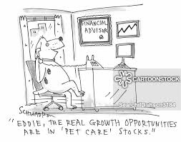
Conflict of Interest
Insider Information.
IESL Clause 6.8
Shall neither disclose nor use confidential information gained in the course of their employment without express permission, except where public interest and safety are involved.

Slide 27
Teamwork
Working effectively as an engineer requires the virtues of loyalty to employers and organizations, colleagues, respect for authority, and contributing to an ethical climate within the organization. It also involves respect for the rights of engineers and others who work together to achieve common goals.
What are the defining features of an ethical corporate climate?
ethical values in their full complexity are widely acknowledged and appreciated by managers and employees alike.
ethical language is honestly applied through a corporate code of ethics or including a statement of ethical responsibilities in the job descriptions of all layers of management.
top management sets a moral tone in words, in policies, and by personal example
there are procedures for conflict resolution.

Slide 28
TEAMWORK
Creates synergy – ultimately if you have a team that works well together the sum is always going to be greater than the parts
Brings new ideas – businesses will always need new, fresh ideas to stay competitive in the workplace. The more diverse the team, the better the ability is to bring unique ideas to the table.
Teamwork helps to solve problems – when you have difficult problems they can’t always be handled by one person. That’s why collaboration with a team that can exchange ideas to facilitate an answer.
It’s supportive – any time you have a team their abilities will vary from one person to the next. That’s why when you have a team with various talents it allows for others to pick up the slack if one member falls behind.

Slide 29

TEAMWORK
Builds trust –The company needs individuals to believe in the firm’s vision and mission. Relying on other people builds trust, and teamwork establishes strong relationships with coworkers
Teaches conflict resolution skills –
Anytime you have a group of people working together, conflicts inevitably arise. Employees have different work styles and habits. While these unique viewpoints create the most successful work, they can also generate resentment that quickly turns into conflict.

Slide 30


Slide 31
ACKNOWLEDGEMENT
Charles Harris, Michael Pritchard, Michael Rabins : Engineering Ethics – Concepts and Cases; Wadsworth Cengage Learning, 4th Edition
Introduction to Engineering Ethics by Mike W. Martin Professor of Philosophy Chapman University and Roland Schinzinger Late Professor Emeritus of Electrical Engineering University of California, Irvine : McGraw Hill Higher Education : ISBN 978-0-07-248311-6 MHID 0-07-248311-3
https://www.mycustomer.com/experience/loyalty/emotional-vs-transactional-loyalty-is-it-more-important-to-win-hearts-or-minds
https://www.vectorstock.com/royalty-free-vector/bribery-money-bag-concept-background-isometric-vector-22606620
https://www.cartoonstock.com/directory/c/conflicts_of_interest.asp
https://www.bing.com/search?q=confidentiality+meaning&form=ANSPH1&refig=df41d450
confidentiality cartoon images - Bing
evenueconsultant.com/2017/11/30/importance-teamwork-workplace/

Slide 32


THANK YOU !!!

